Slide 1
IEDB MySql Query Problems
Allen Cao

Slide 2
Problem 1: MHC class II
SELECT COUNT(*)
FROM tcell t, mhc_allele_restriction mar
WHERE mar.displayed_restriction = t.MHC_ALLELE_NAME
AND mar.class=“II”

Slide 3
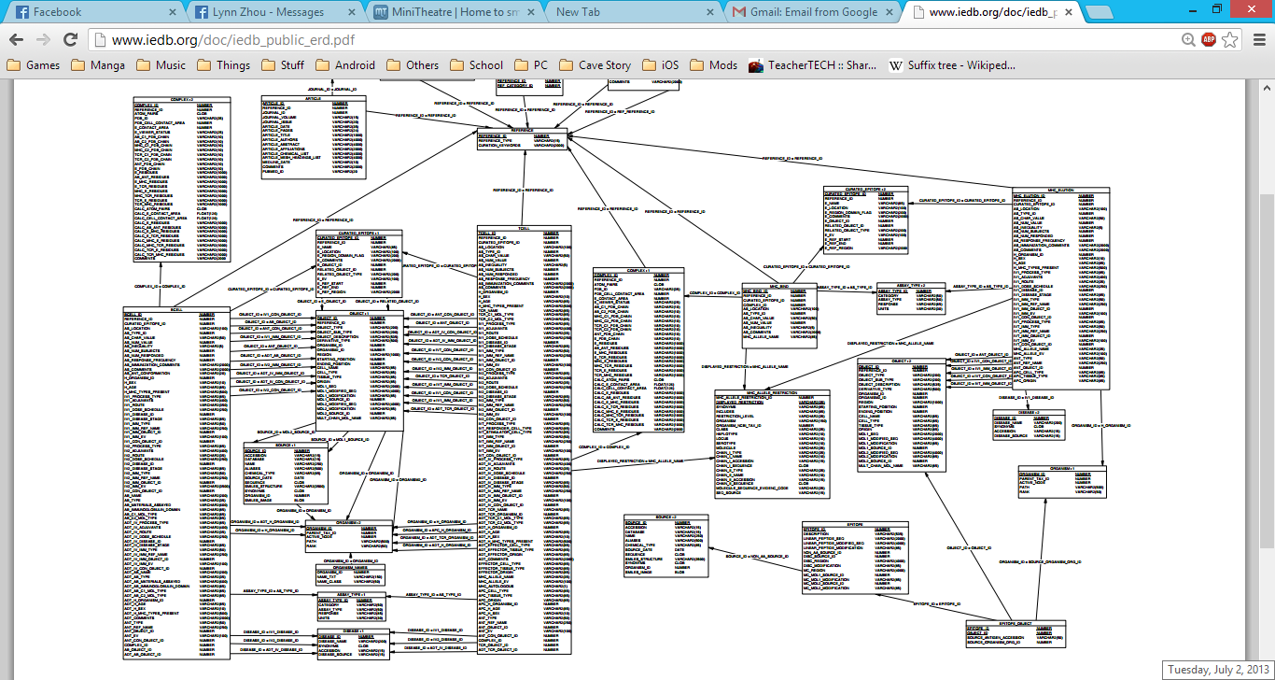

Slide 4
Problem 1
CREATE OR REPLACE VIEW epi AS
(SELECT DISTINCT e.epitope_id
FROM tcell t,
mhc_allele_restriction mar,
curated_epitope ce,
object o,
epitope_object eo,
epitope e
WHERE mar.displayed_restriction = t.mhc_allele_name
AND t.curated_epitope_id= ce.curated_epitope_id
AND o.object_id = ce.e_object_id
AND o.object_id = eo.object_id
AND eo.epitope_id = e.epitope_id
AND class = 'II'
AND linear_peptide_seq IS NOT NULL);
CREATE OR REPLACE VIEW pos AS
(SELECT DISTINCT e.epitope_id
FROM tcell t,
mhc_allele_restriction mar,
curated_epitope ce,
object o,
epitope_object eo,
epitope e
WHERE mar.displayed_restriction = t.mhc_allele_name
AND t.curated_epitope_id = ce.curated_epitope_id
AND o.object_id = ce.e_object_id
AND o.object_id = eo.object_id
AND eo.epitope_id = e.epitope_id
AND class = 'II'
AND linear_peptide_seq IS NOT NULL
AND as_char_value LIKE 'Positive%');
SELECT (SELECT COUNT(*) FROM pos) AS Positives, COUNT(*) AS Negatives, SELECT
FROM epi
WHERE epi.epitope_id NOT IN (SELECT pos.epitope_id FROM pos)

Slide 5
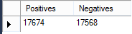
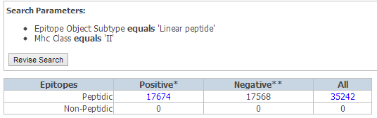

Slide 6
Problem 2-Viruses
CREATE OR REPLACE VIEW epi AS
(SELECT DISTINCT e.epitope_id
FROM tcell t,
mhc_allele_restriction mar,
curated_epitope ce,
object o,
epitope_object eo,
epitope e,
organism org
WHERE mar.displayed_restriction = t.mhc_allele_name
AND t.curated_epitope_id = ce.curated_epitope_id
AND o.object_id = ce.e_object_id
AND o.object_id = eo.object_id
AND eo.epitope_id = e.epitope_id
AND class = 'II'
AND linear_peptide_seq IS NOT NULL
AND org.path LIKE ‘1:10239%');
CREATE OR REPLACE VIEW pos AS
(SELECT DISTINCT e.epitope_id
FROM tcell t,
mhc_allele_restriction mar,
curated_epitope ce,
object o,
epitope_object eo,
epitope e,
organism org
WHERE mar.displayed_restriction = t.mhc_allele_name
AND t.curated_epitope_id = ce.curated_epitope_id
AND o.object_id = ce.e_object_id
AND o.object_id = eo.object_id
AND eo.epitope_id = e.epitope_id
AND org.organism_id = eo.source_organism_org_id
AND mar.class = 'II'
AND e.linear_peptide_seq IS NOT NULL
AND org.path LIKE ‘1:10239%'
AND as_char_value LIKE 'Positive%');
SELECT (SELECT COUNT(*) FROM pos) AS Positives, COUNT(*) AS Negatives
FROM epi
WHERE epi.epitope_id NOT IN (SELECT pos.epitope_id FROM pos)

Slide 8
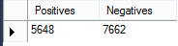
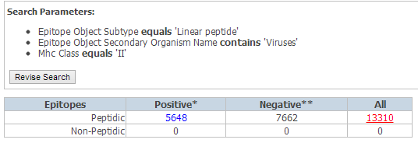

Slide 9
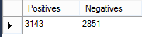
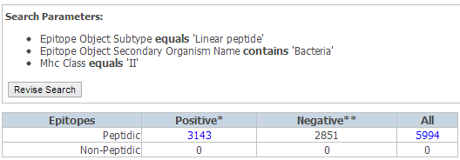
Problem 2:Viruses vs Bacteria
For bacteria use
org.path LIKE ‘1:131567:2:%'

Slide 10
Problem 3-Viruses
CREATE OR REPLACE VIEW epi AS
(SELECT DISTINCT e.epitope_id
FROM tcell t,
mhc_allele_restriction mar,
curated_epitope ce,
object o,
epitope_object eo,
epitope e,
organism org,
object obj
WHERE mar.displayed_restriction = t.mhc_allele_name
AND t.curated_epitope_id = ce.curated_epitope_id
AND o.object_id = ce.e_object_id
AND o.object_id = eo.object_id
AND eo.epitope_id = e.epitope_id
AND obj.object_id = iv1_imm_object_id
AND class = 'II'
AND linear_peptide_seq IS NOT NULL
AND org.path LIKE ‘1:10239%');
CREATE OR REPLACE VIEW pos AS
(SELECT DISTINCT e.epitope_id
FROM tcell t,
mhc_allele_restriction mar,
curated_epitope ce,
object o,
epitope_object eo,
epitope e,
organism org,
object obj
WHERE mar.displayed_restriction = t.mhc_allele_name
AND t.curated_epitope_id = ce.curated_epitope_id
AND o.object_id = ce.e_object_id
AND o.object_id = eo.object_id
AND eo.epitope_id = e.epitope_id
AND org.organism_id = eo.source_organism_org_id
AND obj.object_id = iv1_imm_object_id
AND mar.class = 'II'
AND e.linear_peptide_seq IS NOT NULL
AND org.path LIKE ‘1:10239%'
AND as_char_value LIKE 'Positive%');
SELECT (SELECT COUNT(*) FROM pos) AS Positives, COUNT(*) AS Negatives
FROM epi
WHERE epi.epitope_id NOT IN (SELECT pos.epitope_id FROM pos)

Slide 12
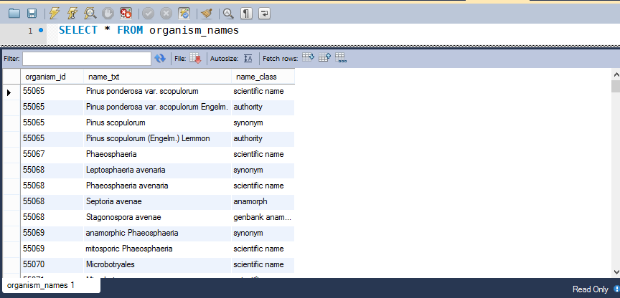
Problem 4
Sorting by organism names….scientific?

Slide 13
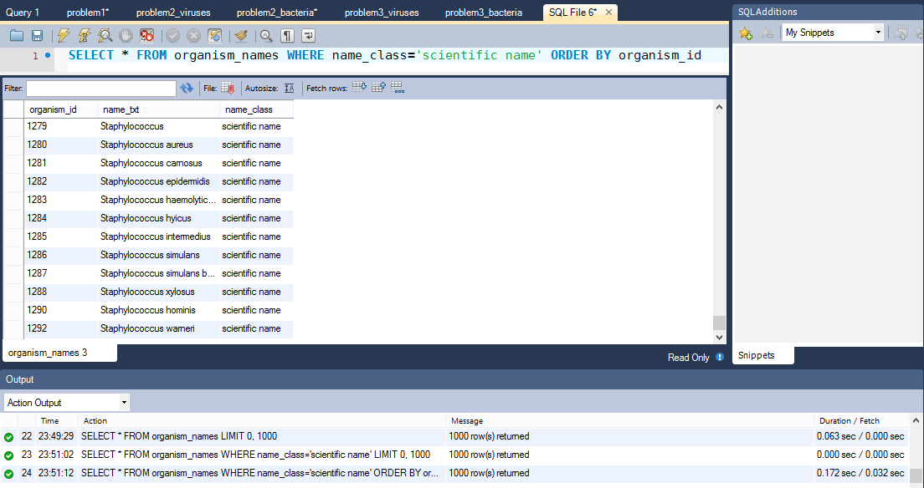
Problem 4-Wrong

Slide 14
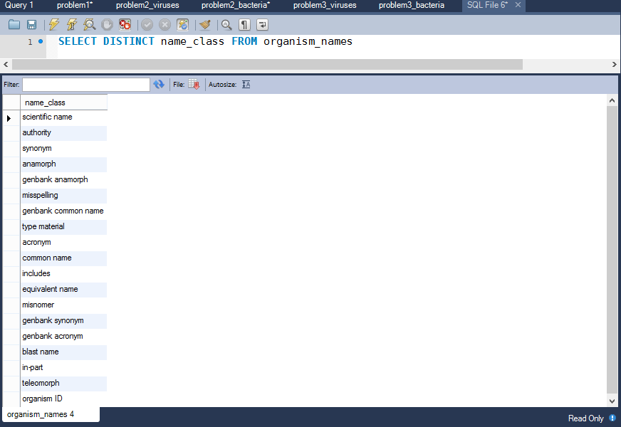
Problem 4- ??

